Slide 1
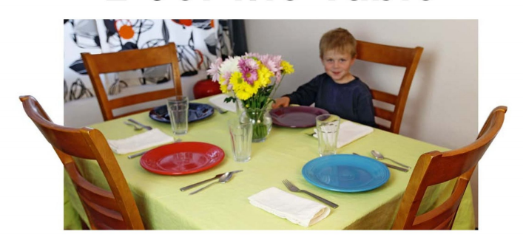
I Set the Table.

Slide 2
Click to see what did you put on the table.
cloth
plate
napkin
fork
knife
spoon
glass
flowers

Slide 3
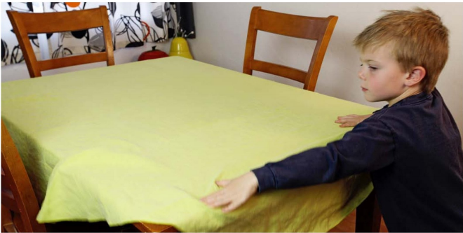
I put the cloth here.
return

Slide 4
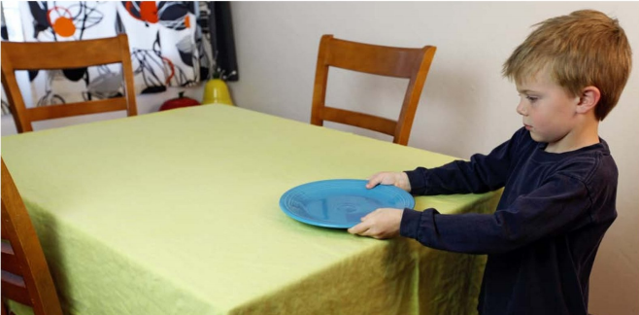
I put the plate here.
return

Slide 5
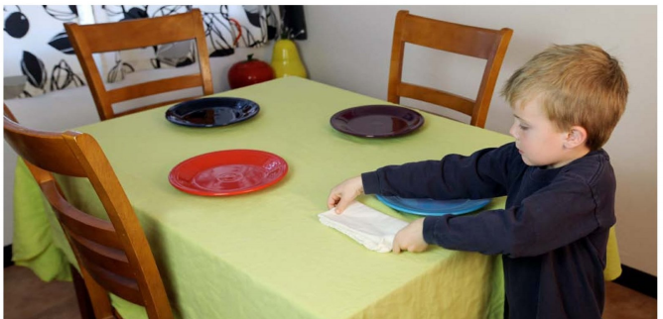
I put the napkin here.
return

Slide 6
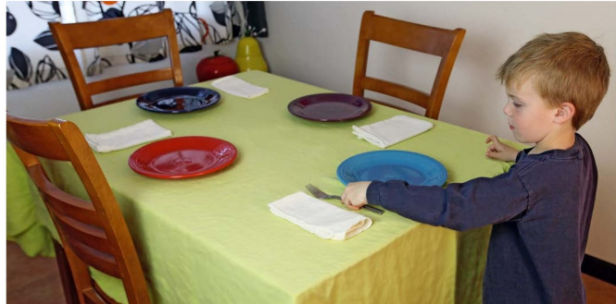
I put the fork here.
return

Slide 7
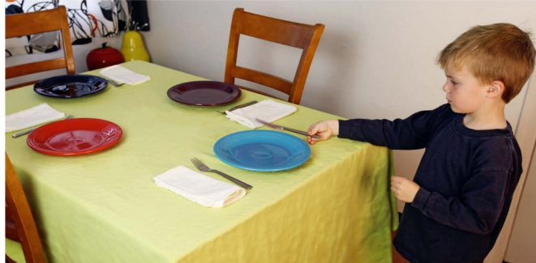
I put the knife here.
return

Slide 8
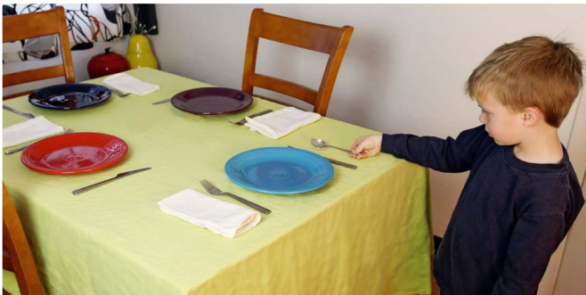
I put the spoon here.
return

Slide 9
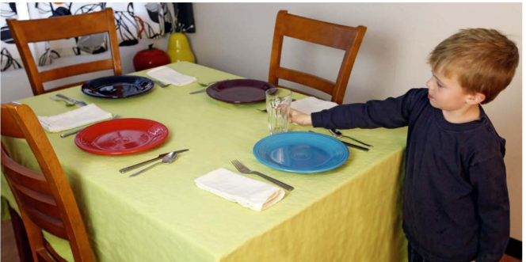
I put the glass here.
return

Slide 10
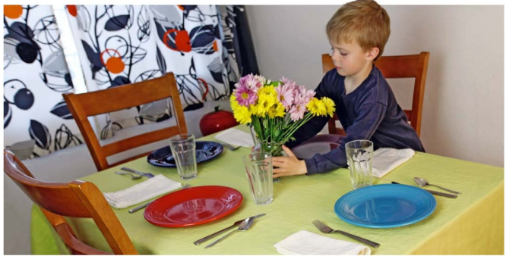
I put the flowers here .
return

